Slide 1
Gestational Trophoblastic
Disease
Epidemiology
Risk factors
Dr.P.Yazdanshenas

Slide 2
Molar pregnancies, although benign, are considered to be premalignant because they have the potential to develop into a malignancy.
Molar pregnancies originate in villous trophoblast and are characterized by abnormal chorionic villi with trophoblast hyperplasia.
Hydatiform mole(premalignant disease) :
Complete mole
Partial mole
Gestational Trophoblastic Neoplasia(malignant disease) :
Invasive mole
Choriocarcinoma
Placental Site Trophoblastic Tumor (PSTT)
Epithelioid Trophoblastic Tumor (ETT)

Slide 3
Complete vs. partial mole :
Complete moles are diploid , produce higher levels of hCG , and are at higher risk of GTN development ( 15-20% vs. 1-5%)

Slide 4
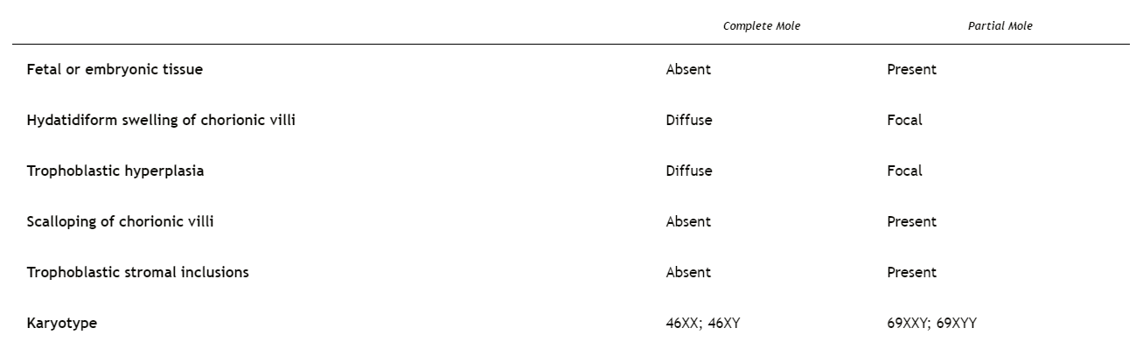

Slide 5
Complete Hydatidiform Mole
Complete moles usually have a 46,XX karyotype, but about 10% have a 46,XY karyotype and the molar chromosomes are entirely of paternal origin with mitochondrial DNA of maternal origin.
Complete moles usually arise from an ovum fertilized by a haploid sperm, which duplicates its own chromosomes. The ovum nucleus may be absent or inactivated.
Rarely, complete moles are biparental and are associated with an autosomal recessive condition predisposing to molar pregnancy. These patients often have recurrent HMs and may require ovum donation to achieve a livebirth.

Slide 6
40% of the patients may have the following signs of marked trophoblastic proliferation at the time of presentation:
hCG level greater than 100,000 mIU/mL
Excessive uterine enlargement
Theca lutein cysts larger than 6 cm in diameter
Patients with any of these signs are at high risk for postmolar persistent tumor

Slide 7
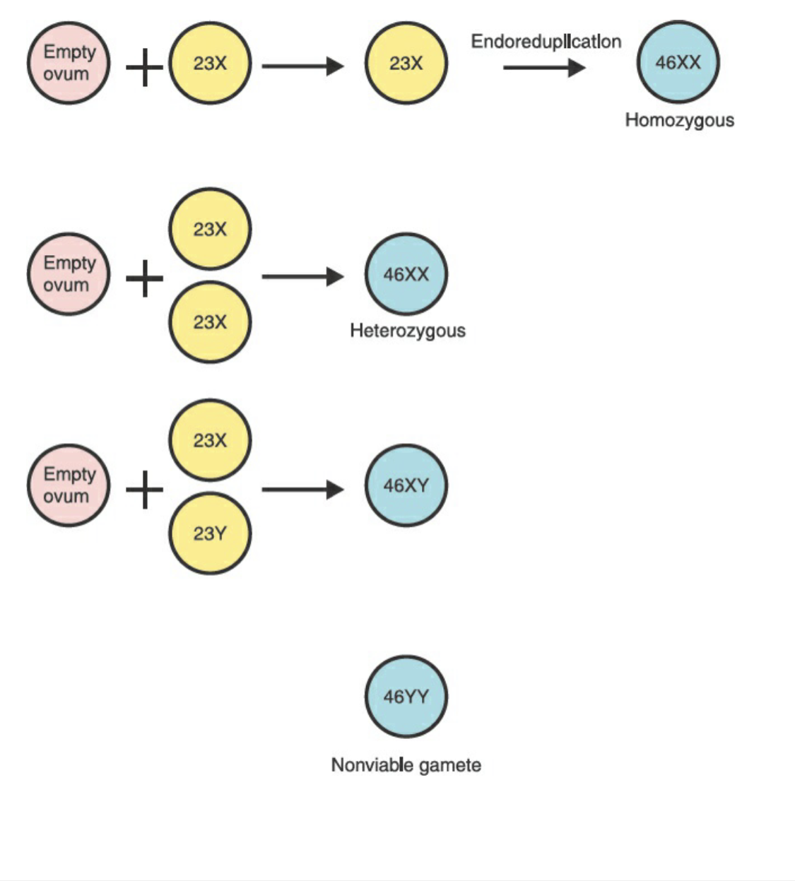

Slide 8
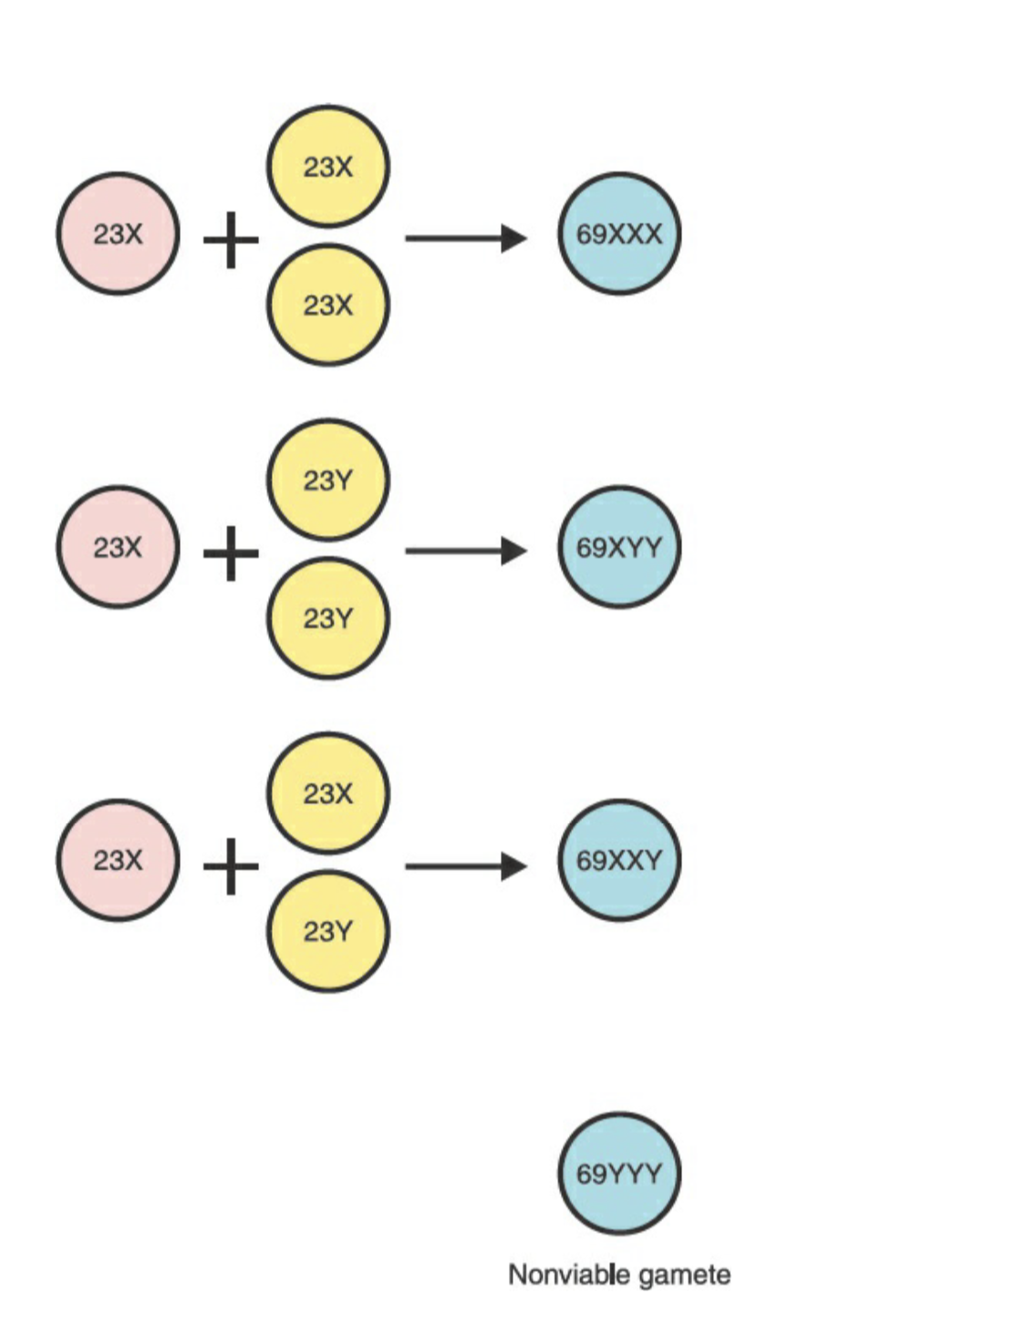

Slide 9
Partial Hydatidiform Mole
Partial moles are triploid, usually resulting from fertilization of an apparently normal ovum by two sperm or occasionally by a diploid sperm, and may therefore be 69XXX, 69XXY, or 69XYY.
Association with the presence of a fetus, and fetal cardiac activity may be detected. However, there is a high rate of intrauterine death related to triploidy.(other presentations of triploidy: growth retardation and multiple congenital malformations such as syndactyly and hydrocephaly.
In general, these patients present with the signs and symptoms of incomplete or missed abortion, and the diagnosis of partial mole may be made only after histologic review of the curettings.

Slide 10
EPIDEMIOLOGY
The incidence of molar pregnancy in Japan (2:1000 pregnancies) is reported to be about threefold higher than the incidence in Europe or North America (about 0.6 to 1.1 per 1000 pregnancies).
In Taiwan, 1 in 125 pregnancies are molar, while in the United States the incidence is 1 in 1500 live births.
While variations in the worldwide incidence of molar pregnancy may result in part from reporting population-based versus hospital-based data, a number of studies suggest that the high incidence in some populations can be attributed to socioeconomic and nutritional factors. The decreasing incidence of molar pregnancy in South Korea is attributed to a more Western diet and improved standard of living.

Slide 11
RISK FACTORS
Prior molar pregnancy
After first molar pregnancy , the risk is approximately 1 to 1.5 percent (approximately 10 to 15 times the risk for the general population)
The recurrence rate after two molar pregnancies has been reported to range from 11 to 25 percent.
Extremes of maternal age
≤15 and >35 years
A case-control study found that the risk for complete mole was increased twofold for patients >35 years and 7.5-fold for patients >40 years
ova from older patients may be more susceptible to abnormal fertilizations that result in HM

Slide 12
The risk for molar pregnancy and its relation to maternal age is much greater in complete mole than partial mole.
Prior spontaneous abortion and infertility
The risk is 3.1 for complete and 1.9 for partial mole.
Infertility is associated with an odds risk of 2.4 and 3.2, respectively, of complete mole and partial mole.
Dietary factors
Low levels of dietary carotene ( Vit A precursor ) , and animal fat.
Partial mole has not been related to dietary factors.

Slide 13
CLINICAL FEATURES
Since 1980s the presentation of HM has changed substantially, due to the availability of both ultrasonography and sensitive quantitative measurement of serum hCG.
However, there has been no change in risk for postmolar tumor. Even when complete mole is diagnosed before 10 weeks gestation, there is no decrease in the risk of GTN .
Prior to this time , HM was usually diagnosed by its late effects (hyperthyroidism, preeclampsia).
Patients with HM typically present to their obstetric clinician with missed menstrual periods, a positive pregnancy test, and signs and symptoms consistent with early pregnancy or early pregnancy complications (bleeding, pelvic discomfort, hyperemesis gravidarum).
Unusually high human chorionic gonadotropin (hCG) levels.
If the products of conception are not examined histologically, the diagnosis of HM may be missed.

Slide 14
Common Features
Vaginal bleeding
The most common presenting symptom and occurs in almost all cases.
Resulting from separation of molar villi from underlying decidua.
Prune juice discharge due to accumulated blood in uterine cavity , undergoing oxidation and liquefaction.
At early gestational ages , pattern does not differ from early pregnancy complications (spontaneous abortion, ectopic pregnancy).

Slide 15
Pelvic pressure or pain
A very common , nonspecific feature due to the enlarging uterus and/or enlarged cystic ovaries.
Enlarged uterus
In only 28% of patients.
May be present for other reasons (eg, incorrect estimate of gestational age, multiple gestation, uterine leiomyomas).
More likely with a complete mole than partial mole.

Slide 16
Hyperemesis gravidarum
In 8% of cases.
May also occur in a normal pregnancy, particularly in multiple gestation.

Slide 17
Hyperthyroidism
Development of hyperthyroidism requires the elevation of hCG >100,000 mIU/mL for several weeks.
In approximately 7% of patients.
Tachycardia, warm skin, and tremor.
May be accompanied by thyroid storm when the patient undergoes anesthesia, due to the release of catecholamines from the adrenal gland.
Because of the homology between hCG and thyroid stimulation hormone and because positive correlations have been observed between serum hCG and total T4 or T3 concentrations.
When hyperthyroidism is suspected, it is important to administer β-adrenergic blocking agents before the induction of anesthesia for molar evacuation, because anesthesia or surgery may precipitate a thyroid storm(manifested by hyperthermia, delirium, convulsions, atrial fibrillation, high-output heart failure, or cardiovascular collapse).

Slide 18
Trophoblastic Embolization
Respiratory distress developed in approximately 2% of our patients with a complete mole.
Chest pain, dyspnea, tachypnea, tachycardia, and severe respiratory distress after molar evacuation.
Respiratory distress usually resolve within 72 hours of evacuation with cardiopulmonary support.

Slide 19
Ovarian theca lutein cysts
>6cm , and develops in approximately half of patients
A form of ovarian hyperstimulation resulting from high circulating levels of hCG and prolactin
Multiloculated, often bilateral, and resolve a few weeks or months after treatment of HM.
May also develop in infertile patients treated with ovulation induction, multiple gestation, or in patients with a normal pregnancy but a hypersensitivity to hCG
After molar evacuation, theca lutein cysts normally regress spontaneously within 2 to 4 months.

Slide 20
Preeclampsia <20 weeks of gestation
1 to 3.5 percent at 8 weeks of gestation.
When complete mole typically presented at later gestational ages, preeclampsia was a more common presentation.
Previously , it was present in 27 percent of patients with complete mole.
Typically develops after 34 weeks of a normal gestation.
At <20 weeks, complete mole should be suspected.
Eclampsia is rare and only anecdotal cases have been reported, usually when a fetus coexists.

Slide 21
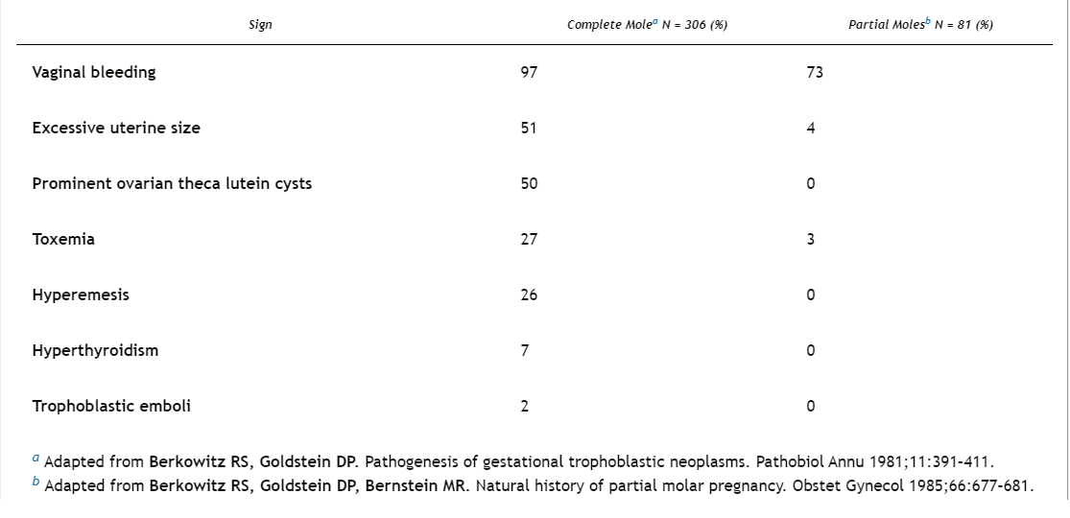

Slide 22
Gestational Trophoblastic Neoplasia
Approximately 50 percent arise from molar pregnancy, 25 percent from pregnancy loss or tubal pregnancy, and 25 percent from term or preterm pregnancy.
15 percent after complete hydatidiform mole will develop local invasion
5 percent will develop metastatic disease.
1 to 4 percent after partial hydatidiform mole.
After a term pregnancy is estimated at 1 per 150,000 pregnancies.
The overall incidence of GTN following all types of pregnancies is estimated at 1 in 40,000 pregnancies .
The main risk factors for the development of gestational trophoblastic disease (GTD) are prior molar pregnancy, advanced maternal age (>40 years), and Asian and American Indian ancestry.

Slide 23
Non-metastatic disease :
Locally invasive GTN develops in 15% of patients after evacuation of a complete mole and infrequently after other gestations.
The trophoblastic tumor may perforate through the myometrium causing intraperitoneal bleeding, or erode into uterine vessels causing vaginal hemorrhage.
Bulky, necrotic tumor may involve the uterine wall and serve as a nidus for infection.
Patients with uterine sepsis present with a purulent vaginal discharge and acute pelvic pain.

Slide 24
After molar evacuation, GTN may exhibit the histologic features of hydatidiform mole, choriocarcinoma, placental site, or epithelioid trophoblastic tumor.
After a normal pregnancy, abortion or ectopic pregnancy, GTN always has the histologic pattern of choriocarcinoma, placental site, or epithelioid trophoblastic tumor.

Slide 25
Placental-Site and Epithelioid Trophoblastic Tumors
These tumors produce small amounts of hCG and human placental lactogen relative to their mass, and tend to remain confined to the uterus, metastasizing late in their course.
Relatively insensitive to chemotherapy.
High cure rates can be achieved with early diagnosis and surgical resection.
They are both more common after a normal pregnancy than after a mole,and are usually diagnosed at the time of hysterectomy.

Slide 26
Metastatic Disease and Choriocarcinoma
Occurs in 4% of patients.
Unlike other malignancies, diagnosis and treatment are based on rising hCG levels rather than a tissue diagnosis.
Approximately one-half of choriocarcinomas follow a hydatidiform mole, and one-half follow nonmolar pregnancies, including term deliveries.

Slide 27
Common sites of metastasis
Lungs
At the time of presentation, 80% of the patients with metastatic GTN show lung involvement on chest radiographs.
Chest pain, cough, hemoptysis, dyspnea, or an asymptomatic lesion on chest radiographs.
Four principal radiographic patterns:
An alveolar or “snowstorm” pattern
Discrete, rounded densities
Pleural effusion
Embolic pattern caused by pulmonary arterial occlusion

Slide 28
Vaginal metastases
In 30% of patients.
Lesions are highly vascular , and can bleed vigorously if biopsied, so attempts at histologic confirmation should be resisted.
Hepatic metastases
In 10% of patients with disseminated trophoblastic tumor.
Almost exclusively in patients with protracted delays in diagnosis and extensive tumor burdens.
Hepatic lesions are hemorrhagic and friable and may rupture, causing exsanguinating intraperitoneal bleeding.

Slide 29
CNS metastases
In 10% of patients.
Cerebral involvement is usually seen in patients with very advanced disease.
All patients with brain metastases have concurrent pulmonary and vaginal involvement.
Nausea and vomiting, headache, seizures, slurred speech, visual disturbances, or hemiparesis.

Slide 30
Relative Incidence of Common Metastatic Sites
LUNGS | 80%
VAGINA | 30%
PELVIS | 20%
BRAIN | 10%
LIVER | 10%
BOWEL , KIDNEY , SPLEEN | <5%
OTHER | <5%

Slide 31


